Slide 1
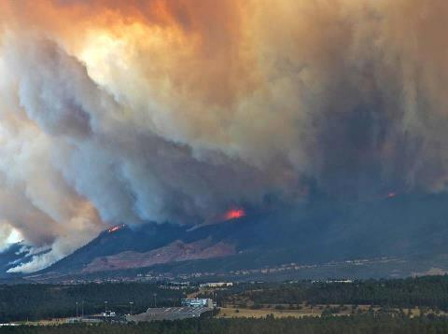
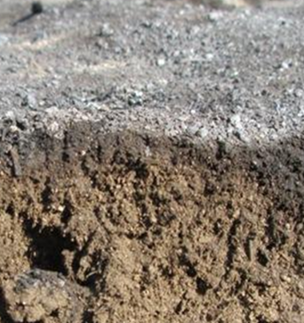

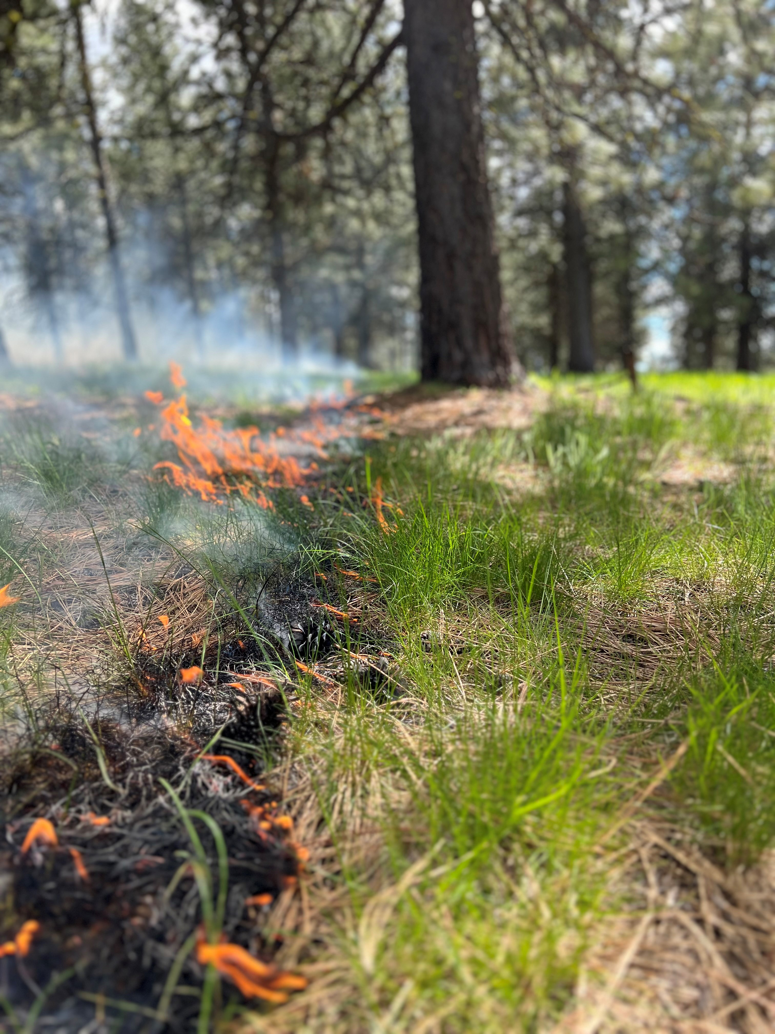
Module 8: Impacts of planned and unplanned fire on forest soil health, including hydrophobicity
Notes:
Introduction, Like Module 5, support the ideas of the previous five modules in the spirit of continuous learning, continuous synthesis, and ultimately the idea of “go slow to go fast” leads to better conservation outcomes and benefits. That said, when fire is involved, there can be two modes, “excellence” in due diligence to support planning that provides a safe, efficient, and effective planned ignition. In the latter, the rapid response to quickly, reliably, and effectively understand the post wildfire environment and its impacts on soil health.

Slide 2
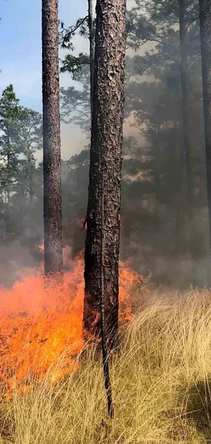
Module 6: A Road Map
Get ready to be “fired-up” with this module
  About Fire
    Physical, Chemical, and Ecological Processes
  Good Fire
    Evolutionary process, negative feedbacks, forest soil health implications
  Bad Fire
    Departed ecological conditions, positive feedbacks, forest soil health implications
Morgan Varner, Tall Timbers
Notes:
This module will touch upon the “burning” topics of the physical, chemical, and ecological processes of fire, the good and bad wildfires, and how they relate to soil health. We will confirm and refute some myths and truths regarding of fire, what it does, and what it doesn’t do to. Keep an open mind, ask hard questions, lets go!

Slide 3
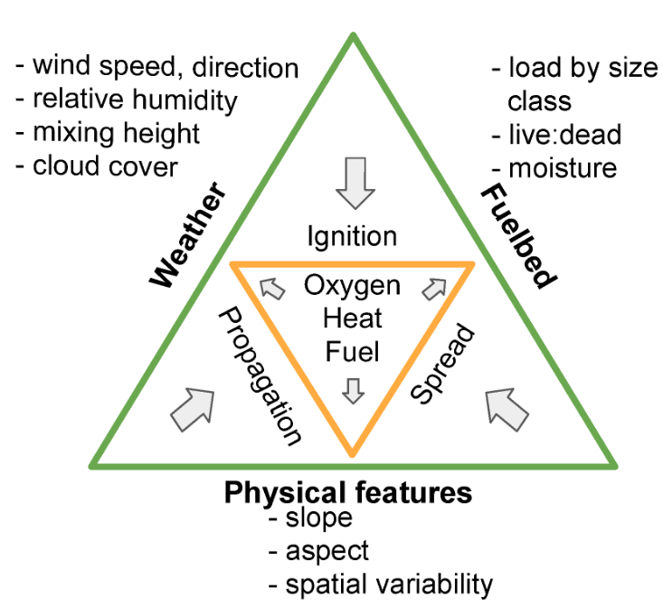
Fire as Physical, Chemical, and Ecological Processes
McGranahan and Wonkka 2018
Notes:
Fire as a Physical, Chemical, and Ecological Processes (slide1)
There are two fire triangles. The first one (in orange) represents the chemical reaction of fire oxygen, heat, and fuel. Which in turns scales up to support the fire behavior triangle (in green), which is topography, fuels, and weather. The one management can address is fuels. The one that primarily drives behavior is weather. In particular, wind aspect of fire weather is the most significant determinant of fire behavior. This variable is able to “wash” over terrain, humidity, fuels, etc with increasing wind speed. Examples to suggest: Low fuels + low wind speed = no fire spread vs low fuels + high windspeed = rapid fire spread.
Citation:
McGranahan, Devan Allen, and Carissa L. Wonkka. 2018. "Wildland Fire Science Literacy: Education, Creation, and Application" Fire 1, no. 3: 52.

Slide 4
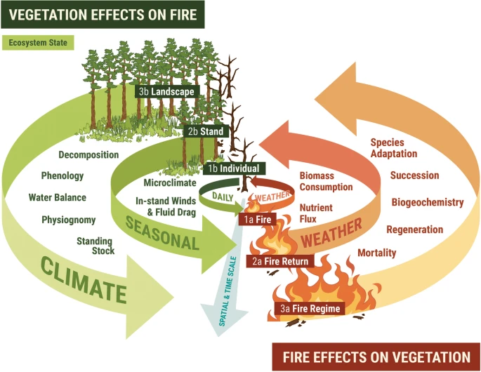
Fire as Physical, Chemical, and Ecological Processes
Fire effects are understood over very small to very large scales of time and space.
Humans tend to focus on the medium scale stuff, what is happening hours to days, over city blocks to a small watershed.
Loudermilk et al 2022
Notes:
Fire as a Physical, Chemical, and Ecological Processes (slide2)
Taking the previous slide and concept, lets now put into scaled in both time and space. From the molecular and microscopic that occurs in seconds to days, to the very large landscapes that are sculpted across multiple century of fire influences. Fire is as natural a process as the sun and the rain. Human’s ability to grasp the micro or the macro can be difficult. Oddly enough, it’s the space where fire is somewhat of a momentary spectacle, not the very small and short or the very large and long, its right there and then. We can use science to bridge these scales and peak beneath this vitally important mechanism of forest soil health.
Terms (uncommon) defined in graph:
Physiognomy: The physical characterization of landscapes
Phenology: the study of the timing and cyclical patterns of events in the natural world, particularly those related to the annual life cycles of plants, animals, and other living things.
Image Citation: Loudermilk, E.L., O’Brien, J.J., Goodrick, S.L. et al. Vegetation’s influence on fire behavior goes beyond just being fuel. fire ecol 18, 9 (2022).

Slide 5
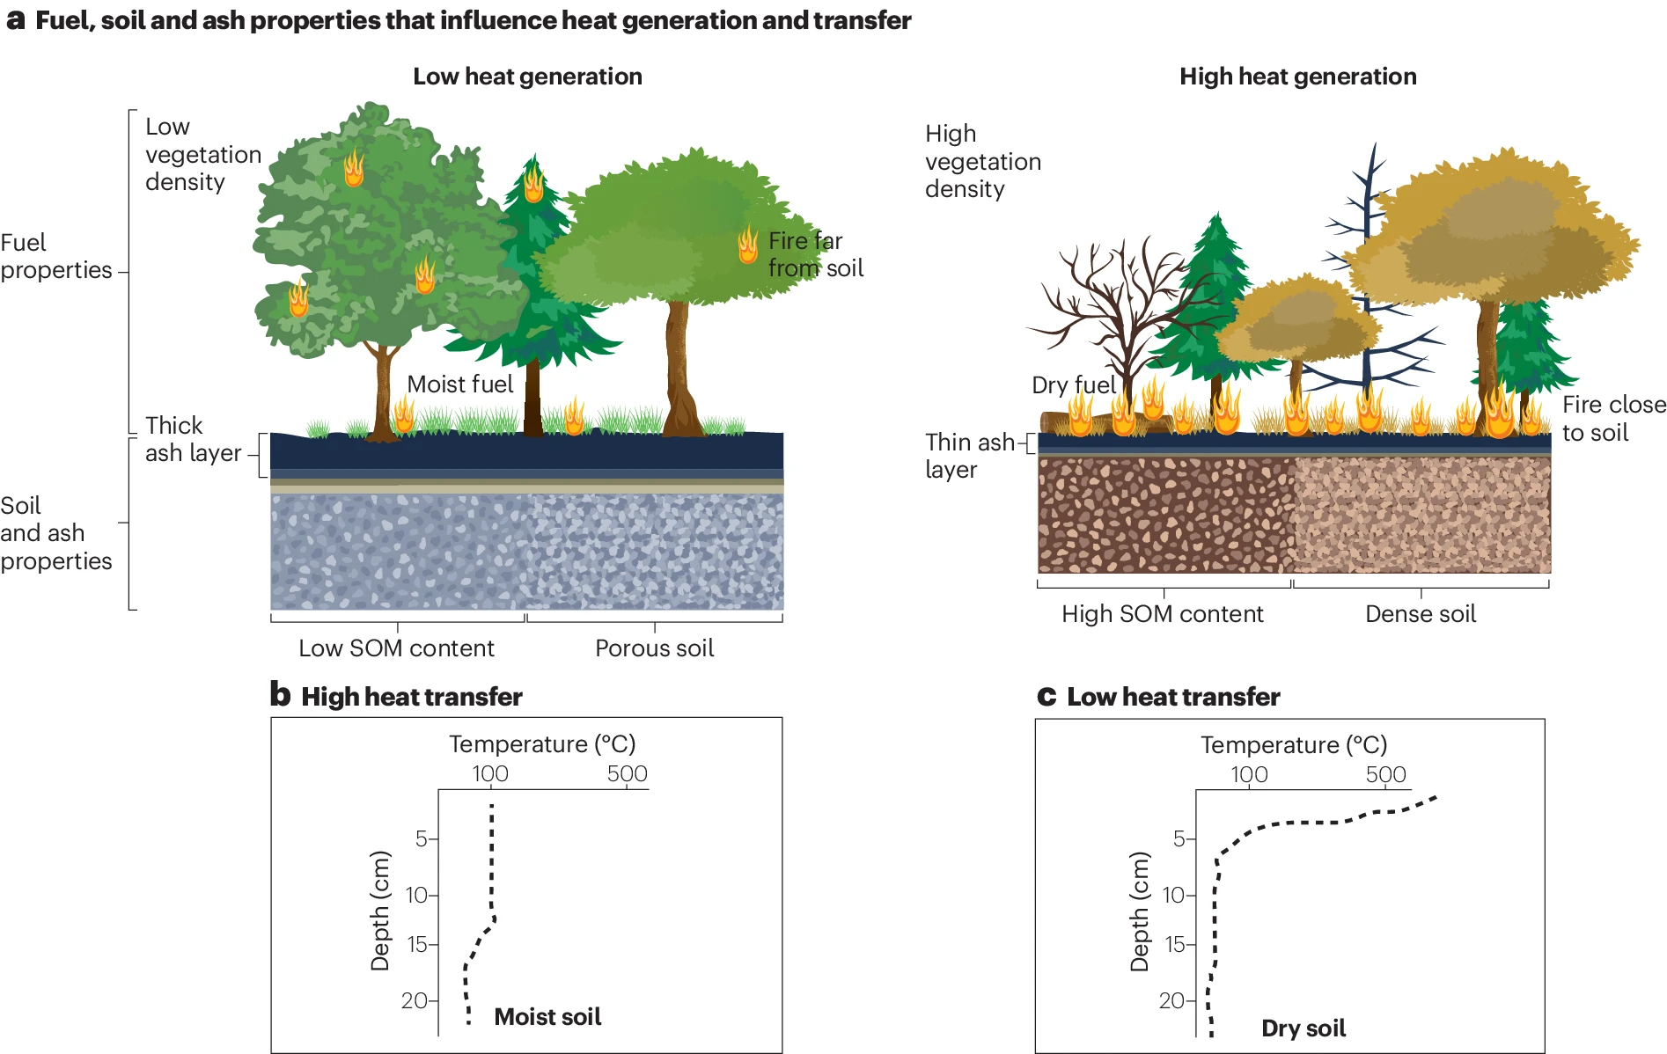
Fire as Physical, Chemical, and Ecological Processes
Lopez et al. 2024
Notes:
Fire as a Physical, Chemical, and Ecological Processes (slide3)
There is a foundational concept in the amount (tons/acre), size (fine vs coarse), water content in the fuels and soils (%), and the soil texture (sand fraction) that influence below ground heat transfer from the surface. If soils are low in SOM and sandy (largely here at the Jones Center), temperatures can be consistent from the surface to 20cm below ground, where as if soils have a high clay fraction with relatively high SOM, temperatures can be very high in the upper horizons and then considerably cooler after just a few centimeters. There are many combinations that can play out.
Where do you think soils are most or least resistant to deep hydrophobicity?
Citation:
Lopez, A.M., Avila, C.C.E., VanderRoest, J.P. et al. (2024). “Molecular insights and impacts of wildfire-induced soil chemical changes”. Nat Rev Earth Environ 5, 431–446

Slide 6
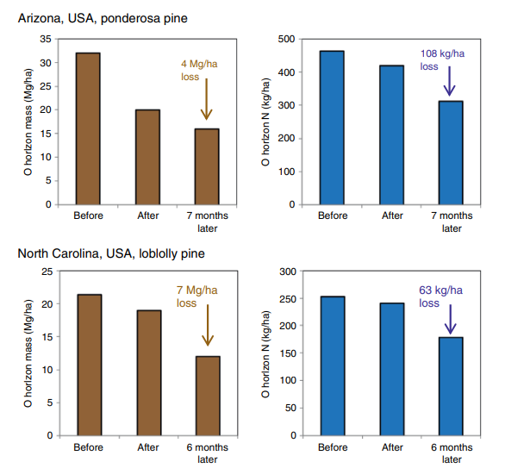
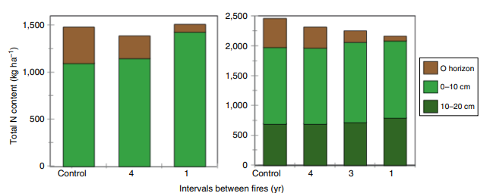
Fire as Physical, Chemical, and Ecological Processes
Total carbon and nitrogen change after prescribed fire
Binkley and Fisher 2020
Bormann et al. 2008
Notes:
Fire as a Physical, Chemical, and Ecological Processes (slide4)
Total carbon and nitrogen change after prescribed fire. The carbon and nitrogen tied up in litter move from the O horizon to the mineral soil strata within the pedon. Both in Arizona and North Carolina, the total carbon and nitrogen fraction continue to decrease even half a year after the fire, this is in part due to decomposition and translocation of material into the A horizon and below. This is illustrated in two studies (upper right) where shorter intervals in put more nitrogen into the lower soil horizons. This has positive impacts on forest soils that are typically nitrogen limited. That is soils (and the plant, fungal, microbial, and arthropod communities and guilds) benefit from more frequent low intensity burns.
Finally, (in the lower right graph) there is still plenty (sometimes up to half) of the nitrogen in the O horizons that is volatilized in fire (due to low vaporization threshold), and that plant available N that is mineralized (Ammonium and Nitrate) tends to be ephemeral for a couple of growing seasons. The amount of plant available nitrogen following a fire depends on how much is volatilized through the fire and the soil pH. Take home. For about every ton of fuel consumed a kilo of N is lost through either volatilization or as highly water transportable nitrate.
Citations:
Graph on the left: Bormann, B.T., Homann, P.S., Darbyshire, R.L., and Morrissette, B.A. (2008). Intense forest wildfire sharply reduces mineral soil C and N: the first direct evidence. Canadian Journal of Forest Science 38: 2771–2783.
Graph on the upper right: Binkley and Fisher 2020> Sampling of soils before and after the Biscuit Fire in Oregon, USA needed to account for the loss of not just the O horizon but also the organic matter and fine mineral material of the upper A horizon. If sampling were done to a fixed depth (represented by the blue and red arrows), the post‐fire sampling would have included material below the depth sampled before the fire, underestimating losses of N and C by 25 and 50% (after Bormann et al. 2008).

Slide 7
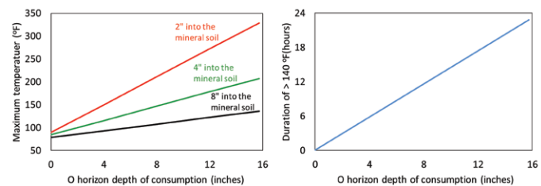
Fire as Physical, Chemical, and Ecological Processes
Kreye et al 2020, via Binkley 2020
Notes:
Fire as a Physical, Chemical, and Ecological Processes (slide5)
Graph on the left: As maximum temperature increases the organic horizon is increasingly consumed, especially in the upper horizons, AND graph on the right: as duration of temps greater than 140F persist for every 6 hours in time another 4 inches of organic horizon is consumed!
Maximum soil temperatures and heat duration in the A horizon depends on the amount of surface fuels and depth of the O horizon. Think about woody residue treatment, pile and burn, or wildfire with high amounts of litter and duff. How would this impact hydrophobicity?
Citation:
Adapted from data taken from Kreye et al, 2020 found in Binkley, D. 2020. Fires and Soils in Frequent-Fire Landscapes of the Southwest. ERI Working Paper No. 43. Ecological Restoration Institute, Northern Arizona University. 11 pp

Slide 8
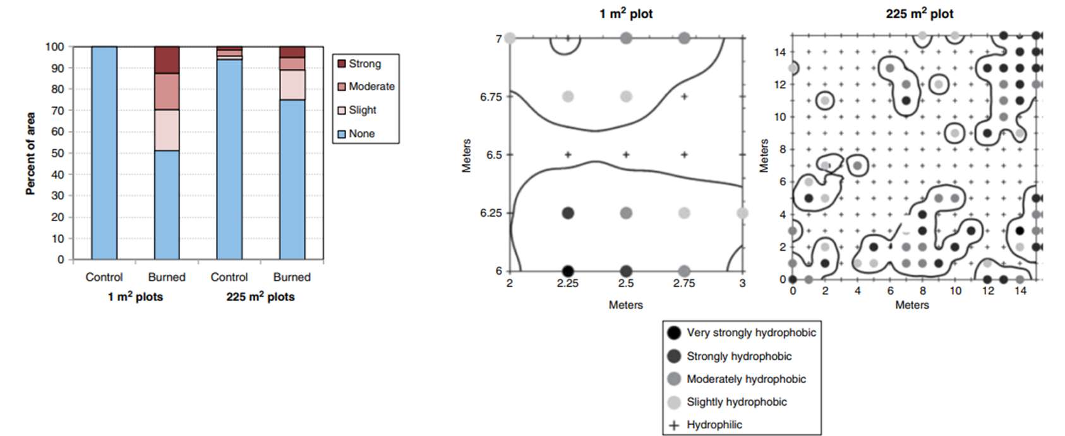
Fire as Physical, Chemical, and Ecological Processes
Woods et al 2007
Notes:
Fire as a Physical, Chemical, and Ecological Processes (slide6)
Hydrophobicity exists in all fires to some spatial extent and for some time frame. The concerning aspects are how much over a concentrated area, for how long of time is critically important to know.
Fire effects are can be understood over very small to very large scales of time and space. Humans tend to focus on the medium scale stuff, what is happening hours to days, over city blocks to a small watershed. In these figures we can see that post fire hydrophobicity as a naturally occurring outcome of normal fire can occur. That is, yes there can be patches, and a large occurrence of hydrophobicity, but is it enough to have a large post fire impact on soil health?
Hydrophobicity occurs in all fires; its density and scale are what matters most. Heterogeneity in first order fire effects occurs. There is decent anecdotal evidence and site-specific research that points to greater than 40-50% high intensity (high soil burn severity class) that begins to have a highly negative impact on surface hydrology, and aggregate stability.
There has been an artful application of principles of hydrophobicity across burned areas. This follows a broad assumption that once a catchment exceeds 40-50% total area burned in moderate to high soil burn severity, that catchments begin to express two-fold up to two orders of magnitude of rainstorm induced hydrologic peak flows and mass transport of soils. Given these graphs, what is your assessment?
Citation:
Woods, S.W., Birkas, A., and Ahl, R. (2007). Spatial variability of soil hydrophobicity after wildfires in Montana and Colorado. Geomorphology 86: 465–479

Slide 9
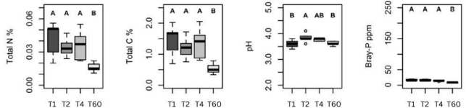
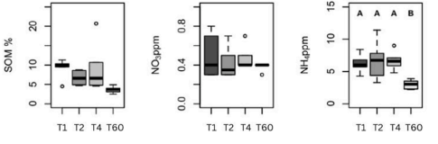
Fire as Physical, Chemical, and Ecological Processes
Time intervals of prescribed fire vs no recent fire on longleaf pine soil chemistry is dramatically different.
Fox et al. 2024
Notes:
Fire as a Physical, Chemical, and Ecological Processes (slide7)
Where Hydrophobicity is one very important aspect of forest soils, the nutrient cycle is also critically important. In all cases (Time since fire interval once a year, every two years, and every four years, Total Nitrogen, Carbon, Phosphorus, SOM and Ammonium were significantly higher in prescribed burn units compared to a stand that hadn’t been burned for 60 years! COOL! That means that low intensity surface fires release nutrients into the soil profile that were otherwise “locked” up in surface biomass. Even cooler!
Citation:
Lopez, A.M., Avila, C.C.E., VanderRoest, J.P. et al. Molecular insights and impacts of wildfire-induced soil chemical changes. Nat Rev Earth Environ 5, 431–446 (2024)

Slide 10
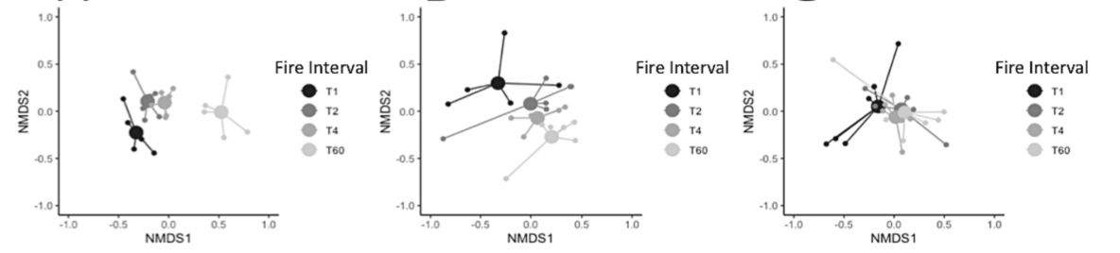
Fire as Physical, Chemical, and Ecological Processes
There are significant changes fungal communities in stands that are allowed to burn and those that are not. This is expressed mostly in the upper horizons.
A horizon
E horizon
Bh horizon
Rx Fire
Rx Fire
No Fire
No Fire
Fox et al. 2024
Notes:
Fire as a Physical, Chemical, and Ecological Processes (slide8)
Then moving from hydrophobicity and biogeochemistry, we characterize the role of low intensity surface fire on fungal and bacterial communities.
These are ordination plots of fungal soil communities, where the axis are not something to interpret, but that the groupings of data are the important patterns to consider. In longleaf forests in this study, prescribed fire is different than non-burned plots on in the A and E horizons, but there is little difference at the Bh horizon.
Citation:
Lopez, A.M., Avila, C.C.E., VanderRoest, J.P. et al. Molecular insights and impacts of wildfire-induced soil chemical changes. Nat Rev Earth Environ 5, 431–446 (2024)

Slide 11
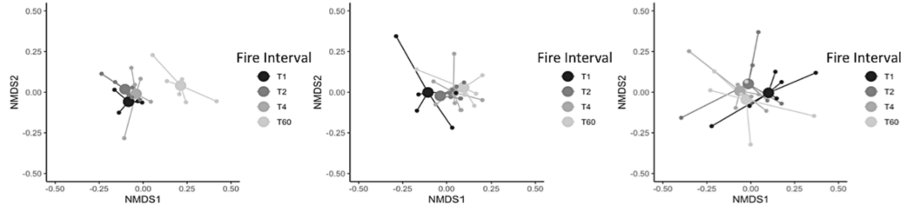
Good Fire or Bad Fire: Forest Soils Do Respond
There are significant changes bacterial communities in stands that are allowed to burn and those that are not. This is expressed mostly in the upper horizons.
A horizon
E horizon
Bh horizon
Rx Fire
No Fire
Fox et al. 2024
Notes:
Fire as a Physical, Chemical, and Ecological Processes (slide9)
Similar to fungal communities, the bacterial communities show a similar response, but not as far down and showing differences mostly in the A horizon, though there are difference in recent fire as opposed to unburned (60 years since fire) in longleaf pine.
Citation:
Lopez, A.M., Avila, C.C.E., VanderRoest, J.P. et al. Molecular insights and impacts of wildfire-induced soil chemical changes. Nat Rev Earth Environ 5, 431–446 (2024)

Slide 12
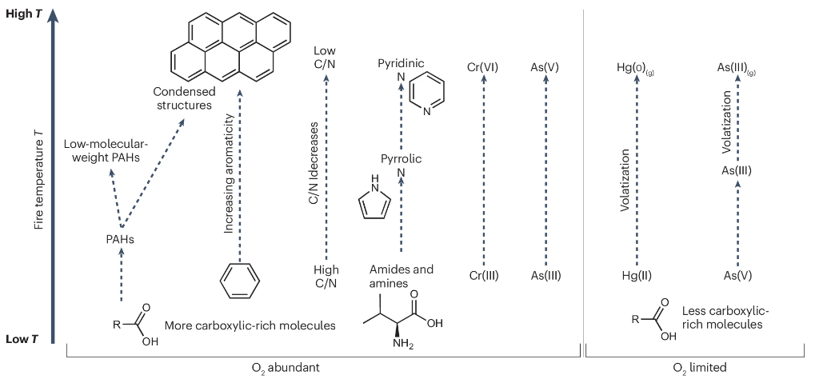
Good Fire or Bad Fire: Forest Soils Respond
Higher Soil Burn Severity
Lower Soil Burn Severity
Lopez et al 2024
Notes:
Good Fire or Bad Fire? (slide1)
Transitioning from low intensity surface fire and now characterizing the role of low AND high intensity fire on these concepts and how they apply to management is our next effort here.
This graph has a lot going on in it, but it synthesizes all the different factors associated with soil based processes and now applies burn intensity. Increases in fire temperatures from burning plant, microbial, and fungal biomass change soil chemistry, resulting in condensed structures that give rise to hydrophobic properties, lower C/N ratios that favor fungal over microbial soil communities, increases in mobilization of heavy metals.
Citation:
Lopez, A.M., Avila, C.C.E., VanderRoest, J.P. et al. Molecular insights and impacts of wildfire-induced soil chemical changes. Nat Rev Earth Environ 5, 431–446 (2024)

Slide 13
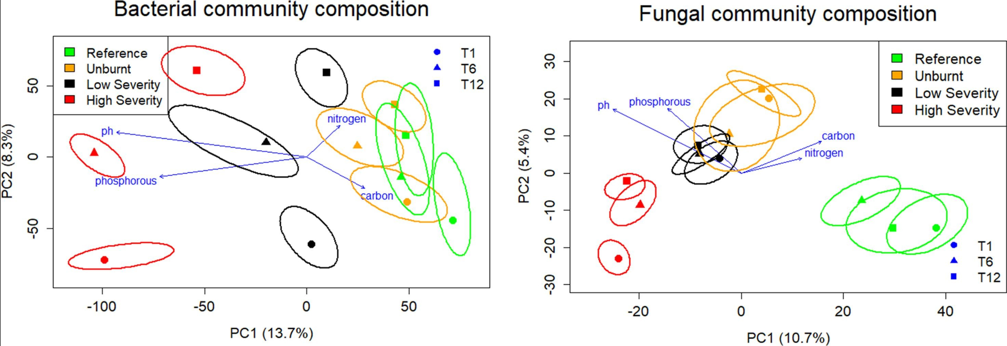
Good Fire or Bad Fire: Forest Soils Do Respond
High severity creates higher pH + P = different bacterial community
High severity creates lower C & N = different fungal community
Notes:
Good Fire or Bad Fire? (slide3)
Like the earlier ordination graphs showing impacts to soil biota; fungal and bacterial communities following prescribed fire, there is a story on how soil burn severity affects these communities. These can occur due to changes in chemical properties and nutrient pools and how fungal and bacterial communities shift.
There are bacterial communities adapted greatest in high intensity fires (in red) and to a lesser but still noticeable low intensity (black) that are driven by changes in pH and phosphorus, whereas unburnt and forests bacterial communities were driven by nitrogen and carbon pools.
But that difference was murkier and less well defined relationship with burn severity based soil chemistry driving fungal communities only benefitted in low severity fires driven by pH and phosphorus, but only a little bit.

Slide 14
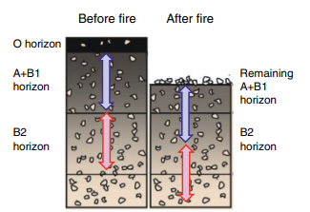
Good Fire or Bad Fire: Forest Soils Respond
Biscuit Fire (Oregon)
  Fire induced subsidence?? combustive erosion??
  Loss of soil site stability (aggregate)
    Below carbon sequestration and storage
  Soil BD
    Compaction impacts on inverts
    Porosity
  What would the soil health indicators suggest here?
Borman et al 2008
Notes:
Good Fire or Bad Fire? (slide4)
High severity fire (like what was observed in the Biscuit Fire in Oregon) showed a significant loss of soil aggregates, not just in it being broken up, but in some cases volatilized and transported. If the A horizon is rich in SOM, that carbon can be trans[ported off-site with actual soil particles.
The loss of O horizons and a sizeable chunk of the A horizon following the Biscuit Fire in Oregon . The stones were imbedded in the carbon rich mineral A horizon. After the fire, all that remained where the stones. Cool! The arrows denote the change in future horizons
Citations:
Bormann, B.T., Homann, P.S., Darbyshire, R.L., and Morrissette, B.A. (2008). Intense forest wildfire sharply reduces mineral soil C and N: the first direct evidence. Canadian Journal of Forest Science 38: 2771–2783.

Slide 15
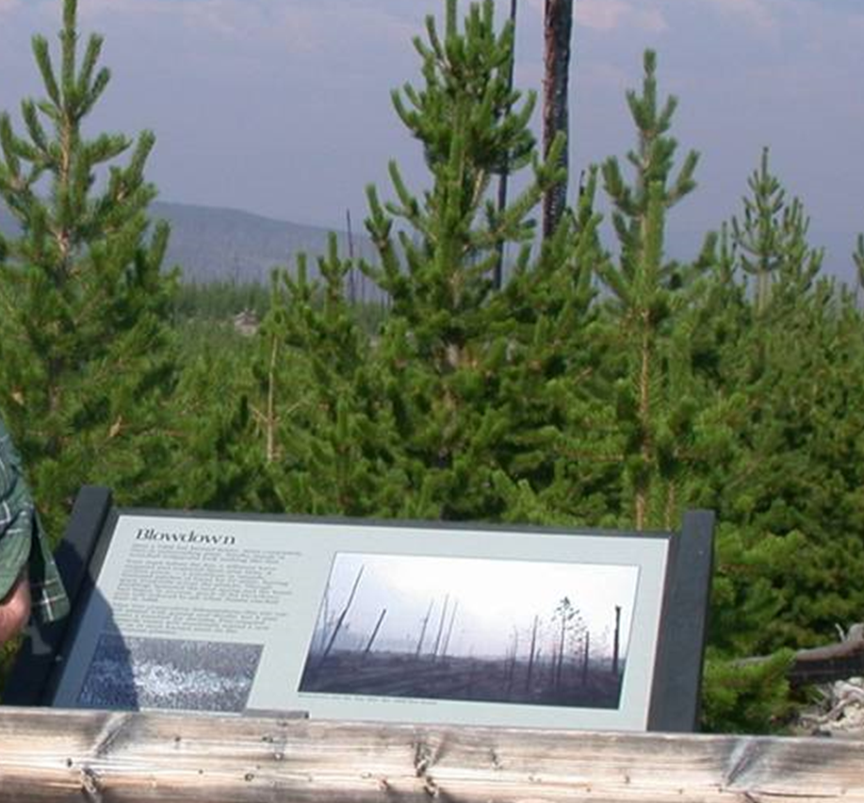
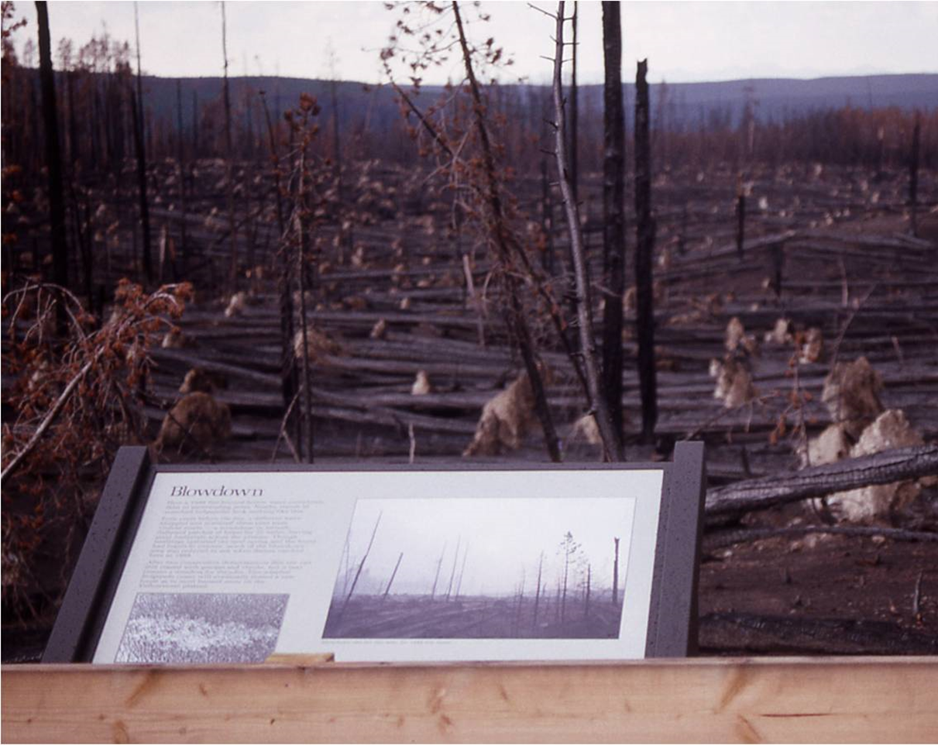
High Severity: Forest Soils Respond
NPS thought this was a bad fire for soils and impact to the plant community, from the 1988 Yellowstone fires...
“After two consecutive deforestations, this site can still reseed with grasses and shrubs, but it may remain a meadow for decades.”
But it isn’t.
Notes:
Good Fire or Bad Fire? (slide5)
Its important to understand the concept that surround the idea of “sterilized” soil. Some sites are coevolved across evolutionary timescales (and in turn soil development) to receive high intensity fire. Because a fire can burn with high intensity, does not mean the severity is high on soils or the plant community!
Take the fires of the Yellowstone National Park in 1988. There were interpretive signs like this, that suggested that given a previous blowdown event that put significant amounts of dead wood on the ground, that the resulting 6” of white ash and resulting moonscape, gave the perception to managers and the public that the site had be sterilized and only hospitable to certain grasses and forbs. The result 20 years later was, not only was the site fully stocked in lodgepole pine, but that as sites measured across the fire impacted park, it was also one of the most annually productive sites post fire.

Slide 16
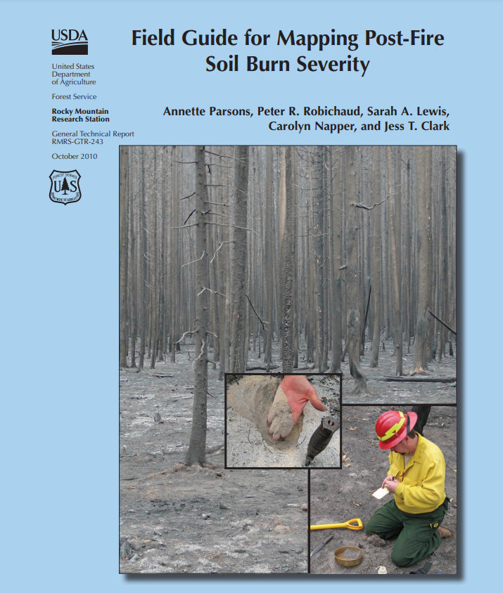
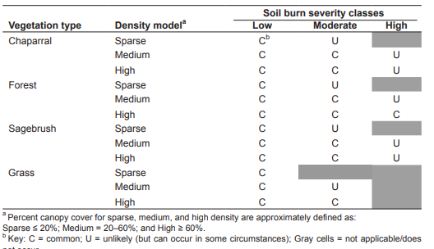
High Severity: Forest Soils Respond
Parsons et. al. 2010
Notes:
Good Fire or Bad Fire? (slide2)
So then how do we understand burn severity and soil health on a systematic way across large landscapes?
Where we experience wildfire, assessments for spatial extent, and relative proportions of soil burn severity protocols are available. In this table, it shows where burn severity will likely be observed given 1) the plant community type, and 2) how much biomass is present.
GTR-243 provides a 5-element approach to understanding soil burn severity in terms of “low”, “moderate”, and “high” severity, based on:
Ground Cover: less than 20% consumption vs. less than 80% surface cover consumed, vs. most to all cover is consumed
Ash type and depth: presence of shallow charred surface fuels vs. fully consumed black ash vs. deep white ash
Soil Structure: aggregates are largely intact vs. aggregates are breaking up easily, vs. there is no aggregates structures observed
Root Structure: fine roots are present and intact vs. fine roots are burned through and discontinuous with some larger roots burned, vs. all fine roots are consumed and large roots are discontinuous
Hydrophobicity: high infiltration present in mineral soil, vs. moderate infiltration and some beading in only upper soil profile, vs. no infiltration with strong beading throughout the upper soil profile
We can further apply these concepts across the range of wildfire areas using vegetation burn severity mapping and apply those maps into inferences of soil burn severity maps.
Citation, Parsons et. Al. 2010. “Field Guide for Mapping Post-Fire Soil Burn Severity” RMRS-GTR-243

Slide 17
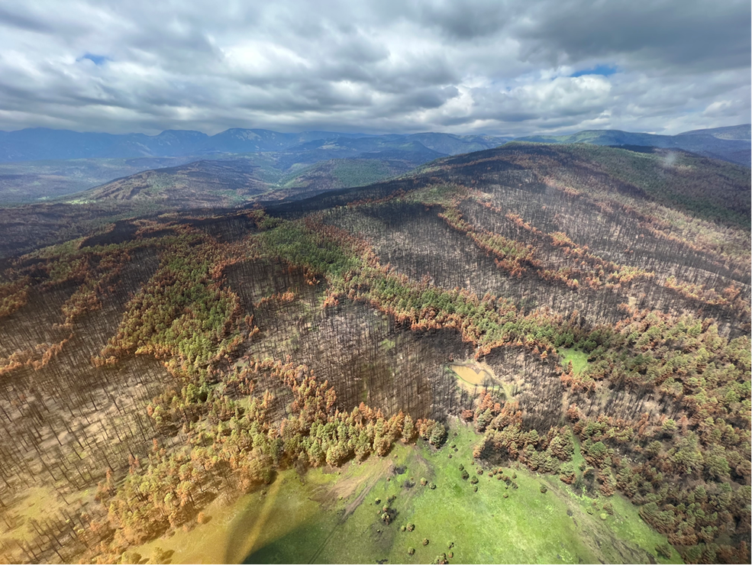
High Severity: Forest Soils Respond
Seeing the post-wildfire soil health story unfold.
Loss of A-Horizon
Erosion and deposition of upper horizons
Feinstein 2022
Notes:
Good Fire or Bad Fire? (slide6)
Distribute these ideas of how physical, chemical, and biotic soil properties change by different soil burn severities across a landscape and over time. Being able to understand general concepts of how fire plays a critical role in pedogenesis and the development of long-term evolutionary environments. Think about climate inputs and feedbacks. Think about when we are called to participate in a post wildfire environment like EWP, how we communicate with our discipline teams, partners, clients, and the public about effects of the fire.
Sometimes soil erosion will be a nuisance that is a problem, but not an emergency. Know the distinction and the tools to address each circumstance is critical. That is a whole other presentation though!
Photo:
Jonas Feinstein – Calf Canyon/Hermit Peak Fire 2022

Slide 18
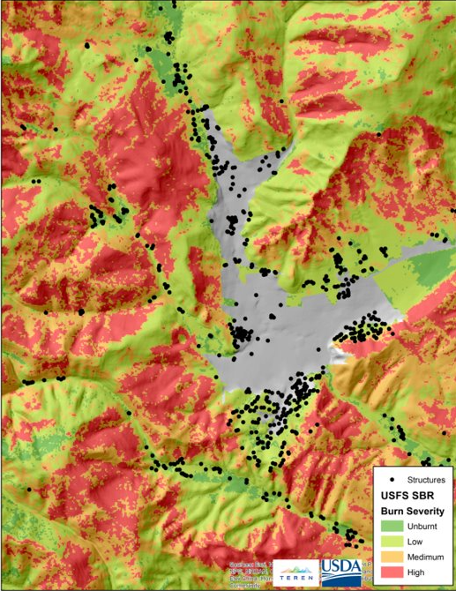
High Severity: Forest Soils Respond
Seeing the post-wildfire soil health story unfold.
  Placing these different impacts across a landscape is important
  What, how much, and where we focus post-fire stabilization efforts
    Detailed mapping and analysis
    Detailed plans of action
    Communication and transparency
Metz, Norman, Feinstein 2022
Notes:
Good Fire or Bad Fire? (slide7)
Distribute these ideas of how physical, chemical, and biotic soil properties change by different soil burn severities across a landscape and over time. Being able to understand general concepts of how fire plays a critical role in pedogenesis and the development of long-term evolutionary environments. Think about climate inputs and feedbacks. Think about when we are called to participate in a post wildfire environment like EWP, how we communicate with our interdisciplinary teams, partners, clients, and the public about effects of the fire.
Sometimes soil erosion will be a nuisance that is a problem, but not an emergency. Know the distinction and the tools to address each circumstance is critical. That is a whole other presentation though!
Image:
John Norman, Lori Metz, and Jonas Feinstein– Calf Canyon/Hermit Peak Fire 2022

Slide 19
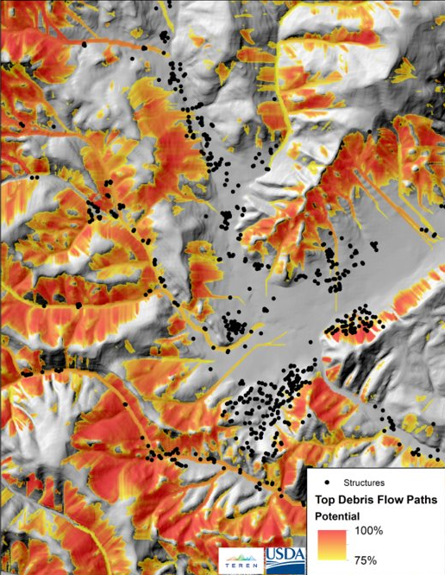
High Severity: Forest Soils Respond
Seeing the post-wildfire soil health story unfold
  Placing these different impacts across a landscape is important
Metz, Norman, Feinstein 2022
Notes:
Good Fire or Bad Fire? (slide8)
Distribute these ideas of how physical, chemical, and biotic soil properties change by different soil burn severities across a landscape and over time. Being able to understand general concepts of how fire plays a critical role in pedogenesis and the development of long-term evolutionary environments. Think about climate inputs and feedbacks. Think about when we are called to participate in a post wildfire environment like EWP, how we communicate with our discipline teams, partners, clients, and the public about effects of the fire.
Sometimes soil erosion will be a nuisance that is a problem, but not an emergency. Know the distinction and the tools to address each circumstance is critical. That is a whole other presentation though!
Image:
John Norman, Lori Metz, and Jonas Feinstein– Calf Canyon/Hermit Peak Fire 2022

Slide 20
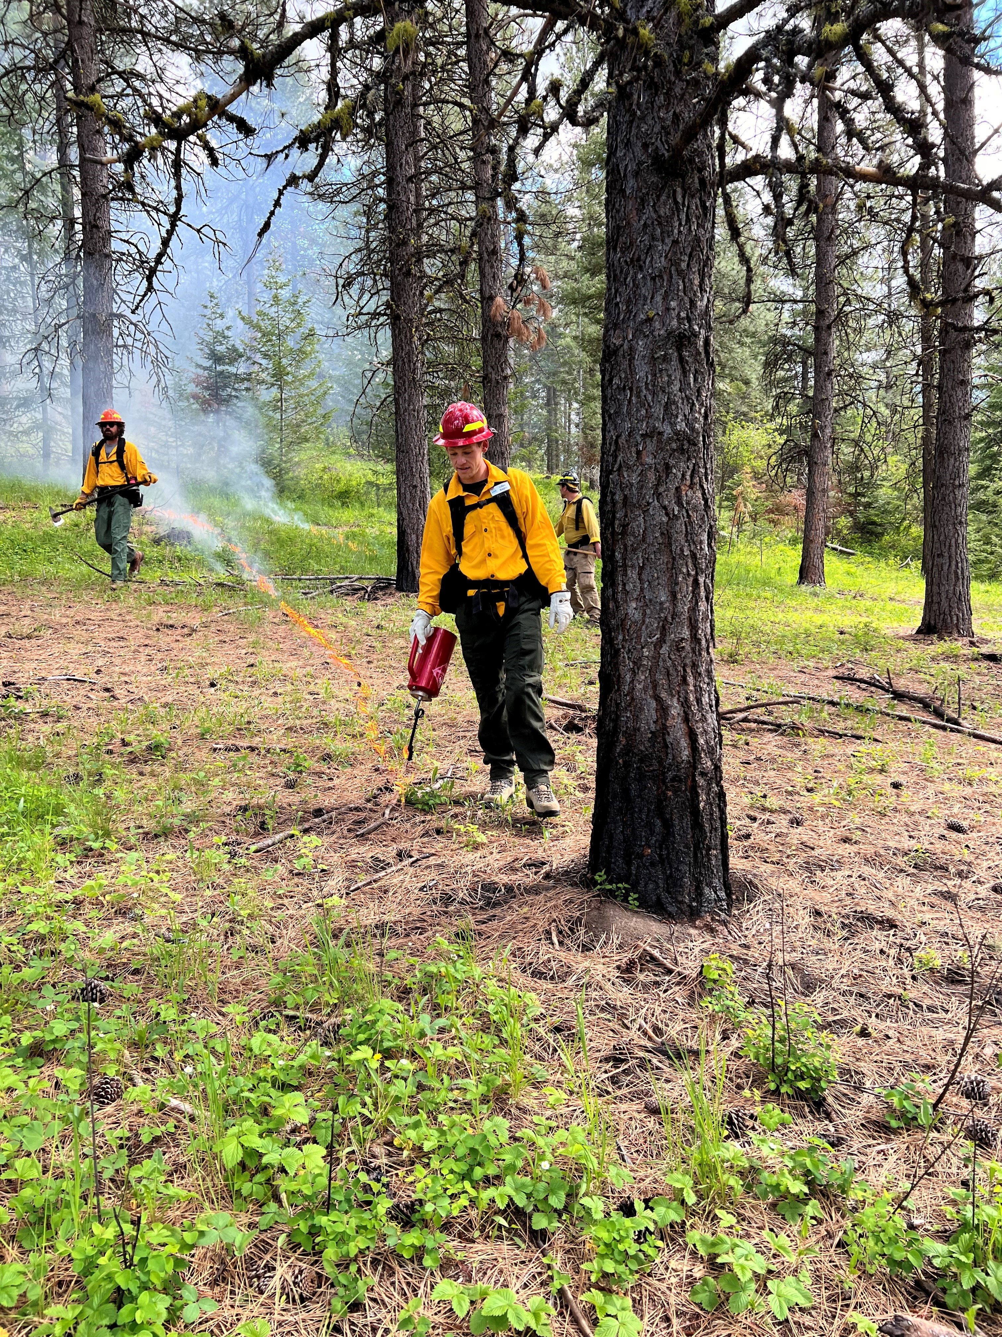
“Good” Fire and Soil Health: The Take Home
Fire is as natural as the sun and the rain
  Fire effects on nutrient pools is straight forward.
    Soil Organic Matter increases!
    Nitrogen increases, but is highly mobile
    Phosphorus can marginally increase
  Soil biotic communities shift and thrive in post fire environments if it doesn’t get too hot.
  Hydrophobicity happens in good fires too, just not as much and persist as long
  Prescribed Burning 338 is a soil health practice!
Notes:
Good Fire or Bad Fire? (slide9)
“Good” fire take homes
As the slides say. Drive these home!
Photo: Jonas Feinstein, NRCS Prescribed Fire Training, La Grande, OR 2024

Slide 21
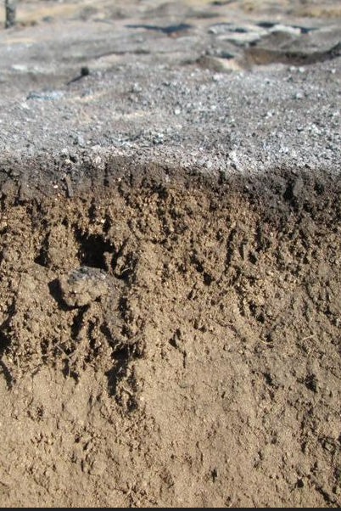
“Bad” Fire and Soil Health: The Take Home
Widespread and uncharacteristic fires
  Significant losses of O and sometimes A horizons.
    Soil Organic Matter losses!
    Nitrogen is volatilized!
    Heavy metals are isolated and transportable!
  Soil biotic communities significantly shift to be bacteria dominated.
  Where hydrophobicity is widespread (>40% of a watershed) and contributes to erosion, transport of heavy metals, hydrologic peak flows, and ash
Photo: USFS
Notes:
Good Fire or Bad Fire? (slide10)
“Bad” fire take homes
As the slides say. Drive these home!

Slide 22
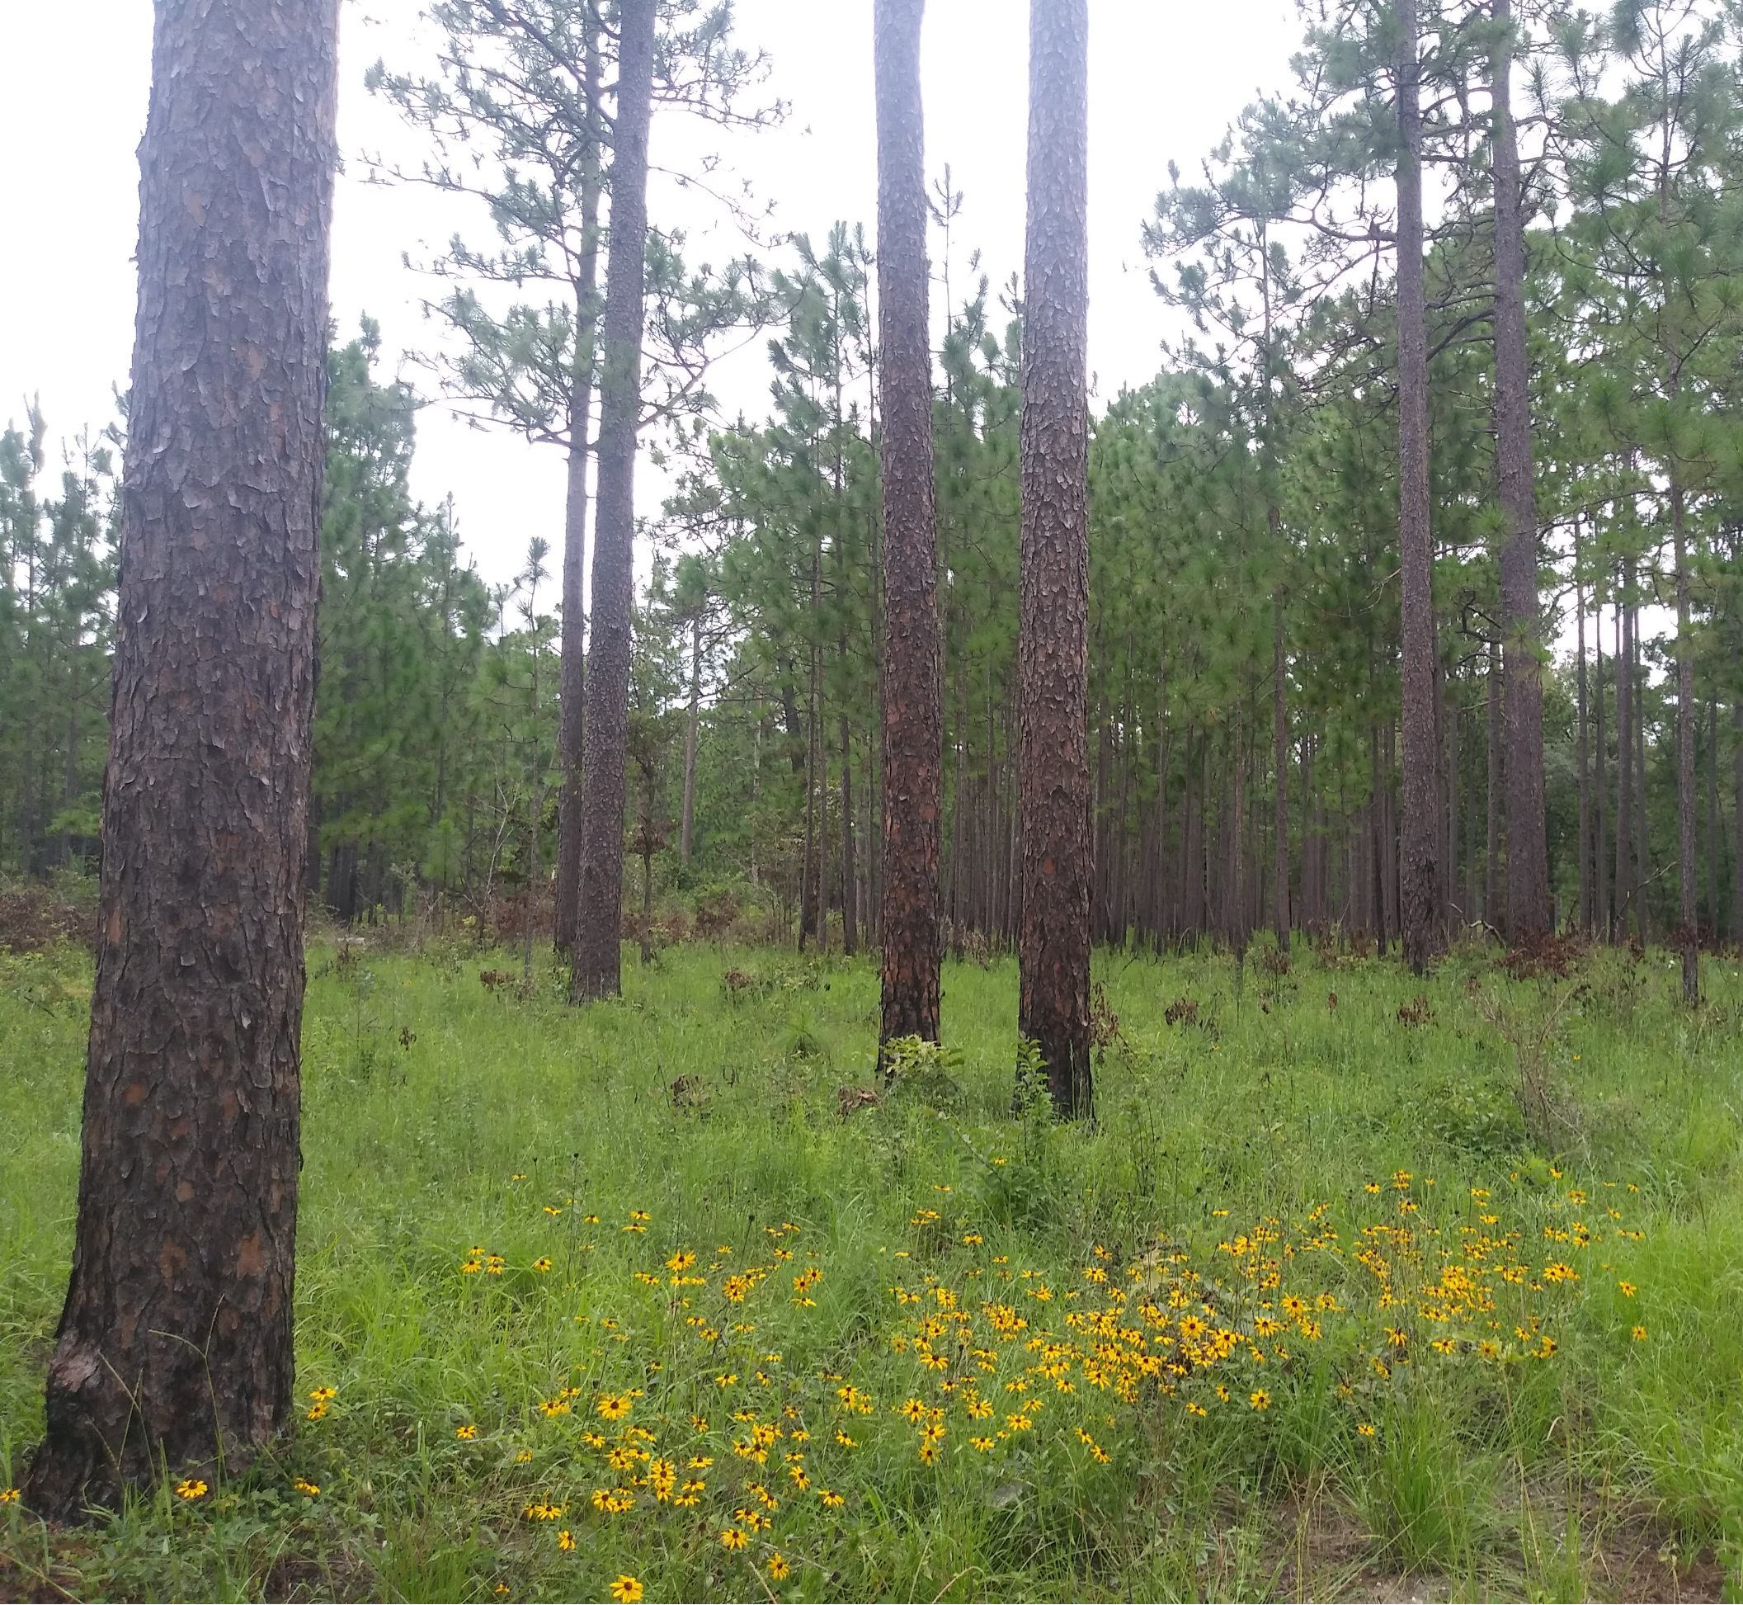
Many Thanks
For more information on Managing Soil Health,
visit us here:
https://www.nrcs.usda.gov/conservation-basics/natural-resource-concerns/soils/soil-health
USDA is an equal opportunity provider, employer, and lender.

